Slide 1

Segmentation
of Vessels in
Retinal Images
Group 6
Shiyu Wang
Jiacheng Ma
Joe Wang
Enhao He

Slide 2

Introduction

Slide 3
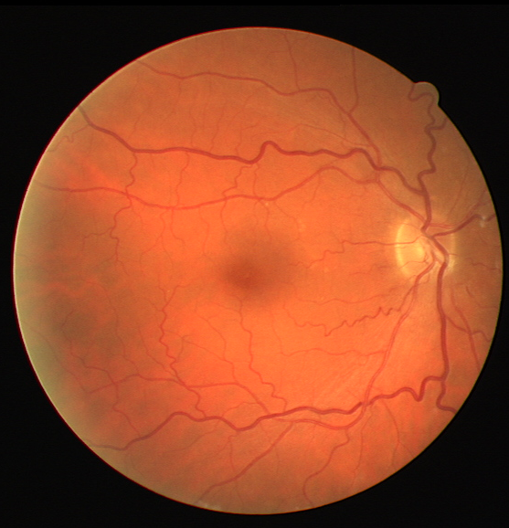
Introduction
Objective: Segment blood vessels in retinal images to support early diagnosis of eye diseases like diabetic retinopathy and glaucoma.
Dataset: DRIVE — 40 fundus images (33 healthy, 7 with early diabetic signs), includes expert manual segmentations.
Challenges: Low vessel-background contrast, complex vessel morphology, inconsistent illumination.
Methods:
K-means Clustering
Naive Bayes Classifier
Support Vector Machine (SVM)
Random Forest Classifier

Slide 4
Methods
&
Results

Slide 5
K-Means Clustering

Slide 6
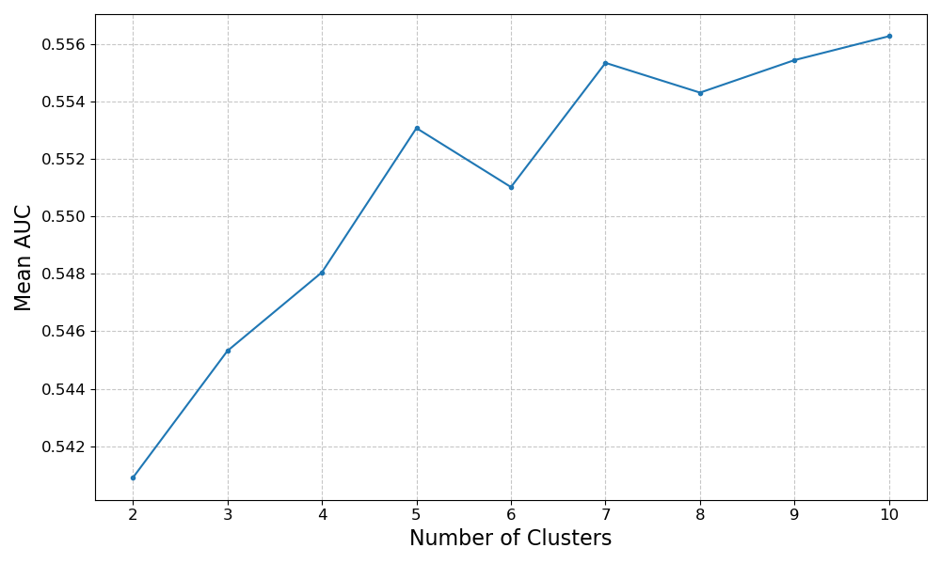
K-Means Clustering
Find the best n_clusters

Slide 7
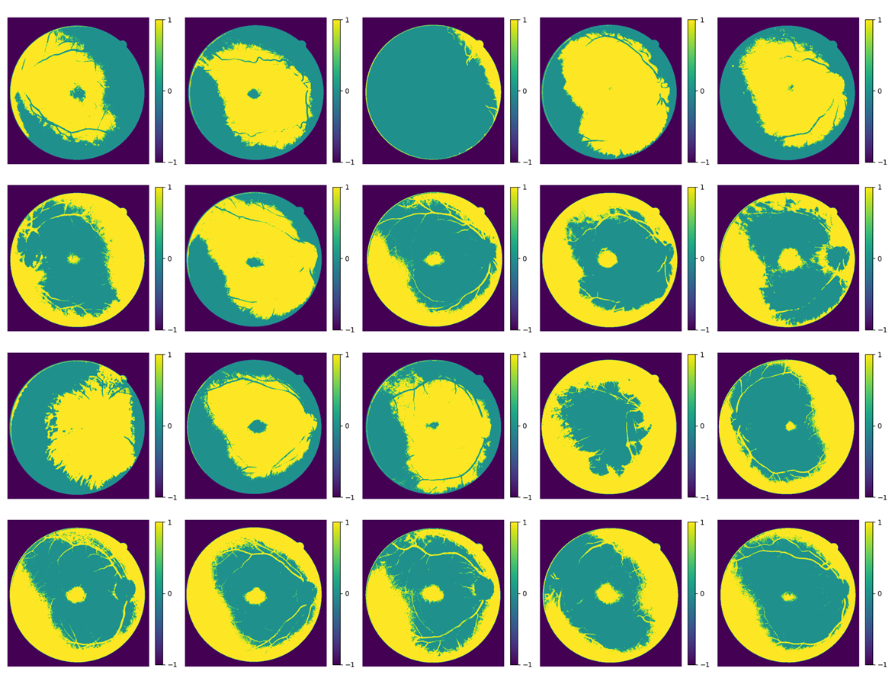

Slide 8
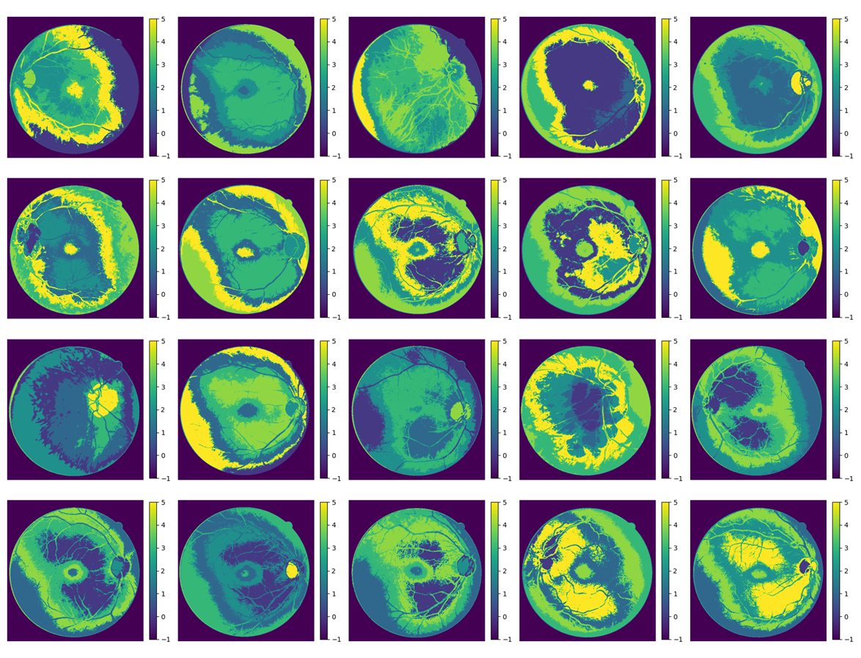

Slide 9
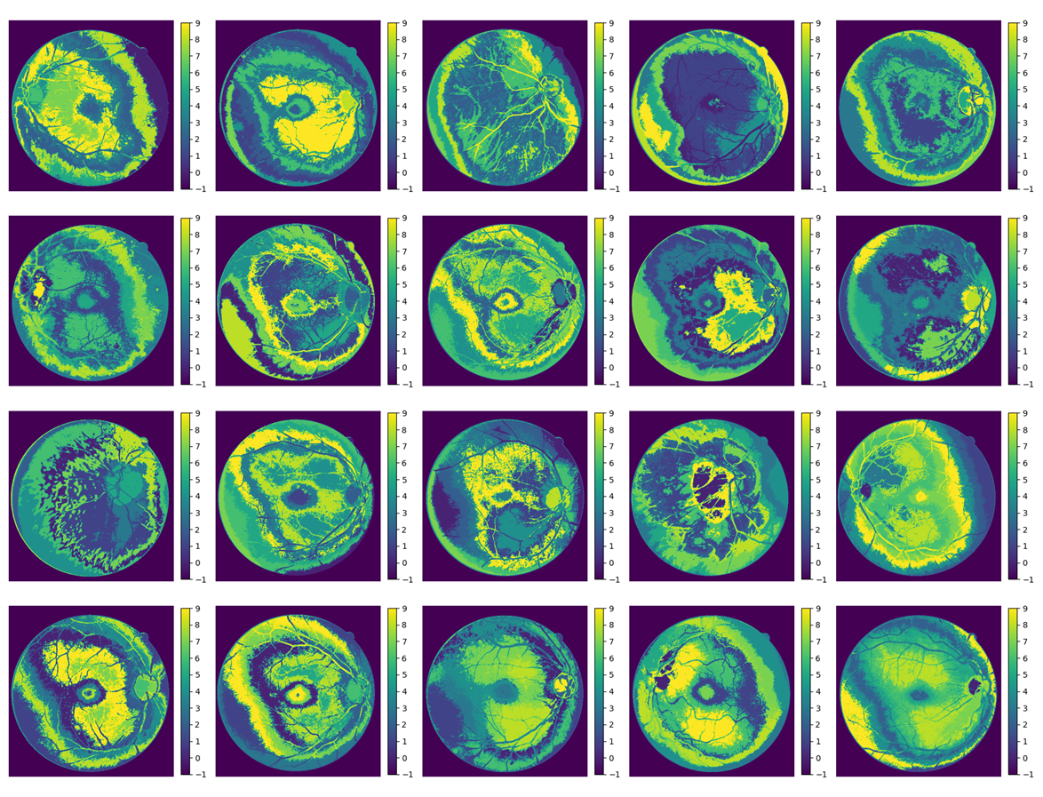

Slide 10
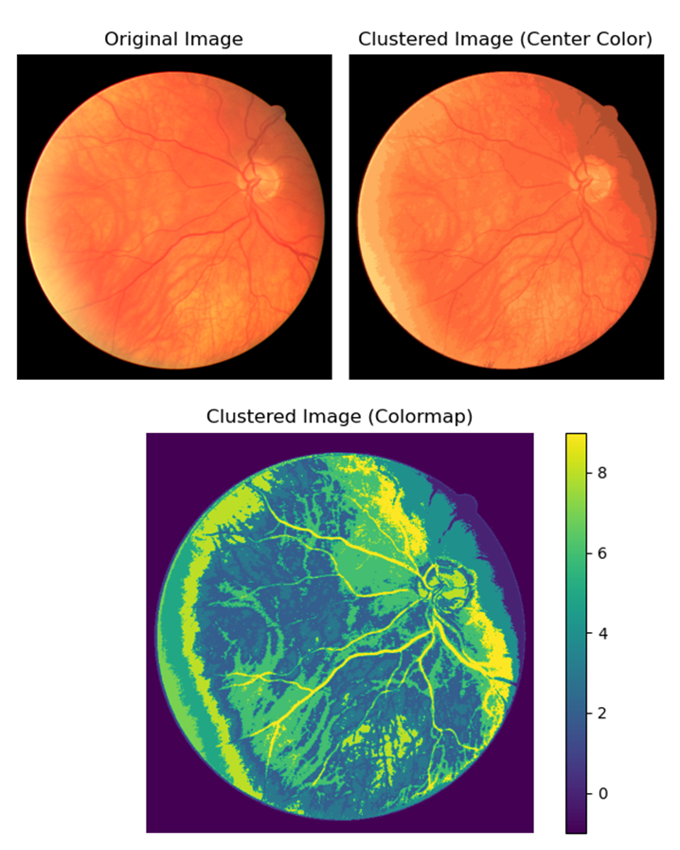

Slide 11
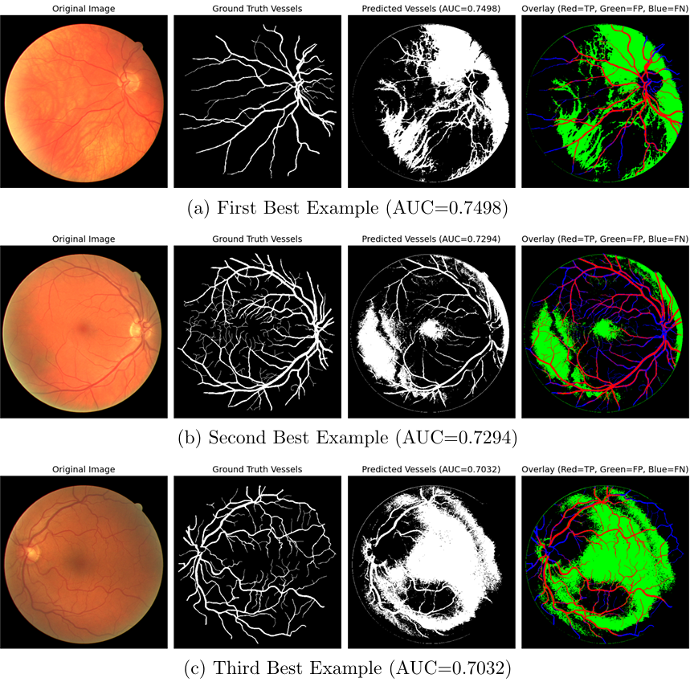
Optimized K-Means Algorithm

Slide 12
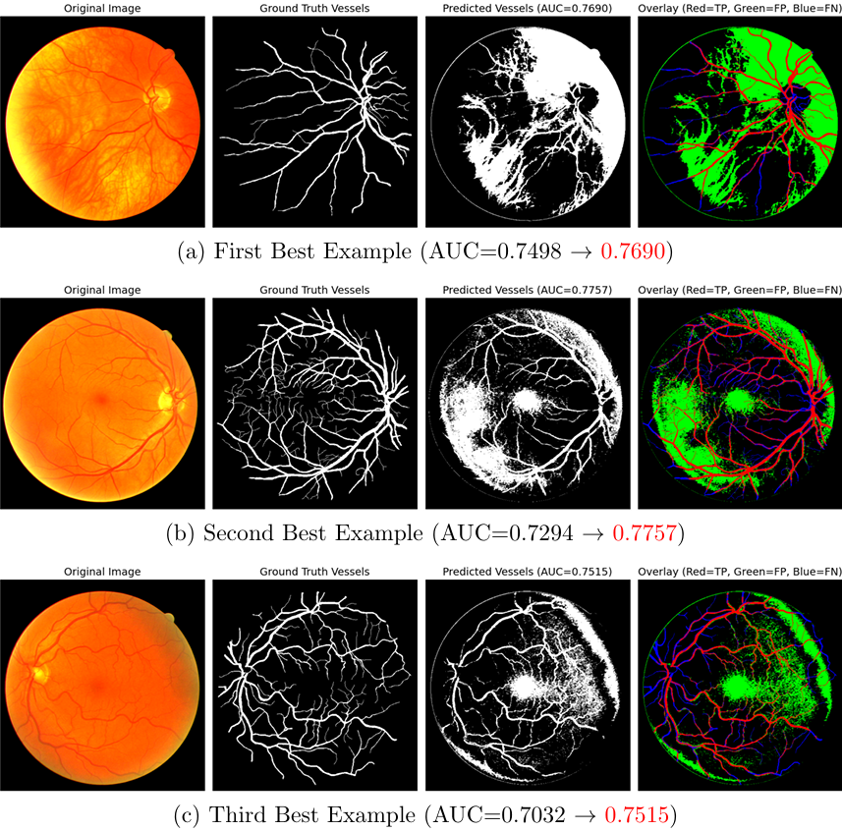
Optimized K-Means Algorithm

Slide 13
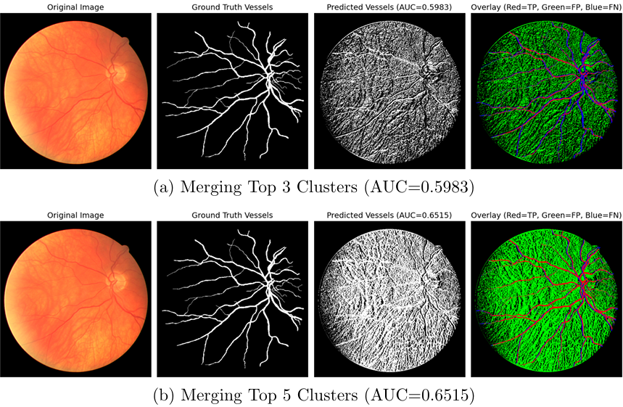
Direction-enhanced K-Means Clustering

Slide 14
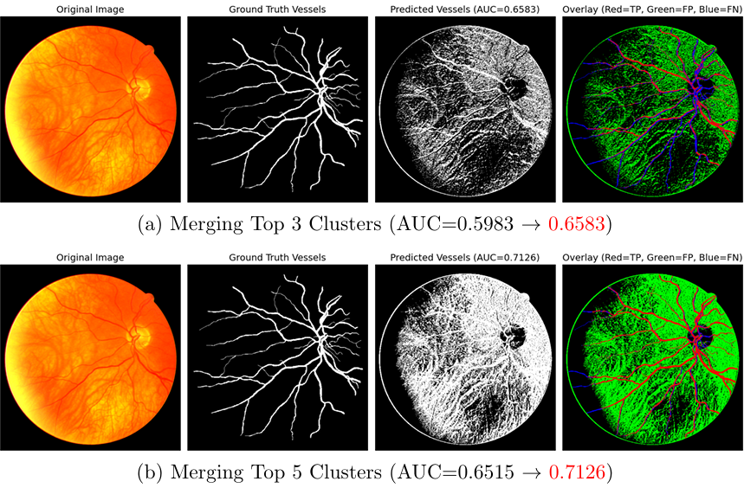
Direction-enhanced K-Means Clustering

Slide 15
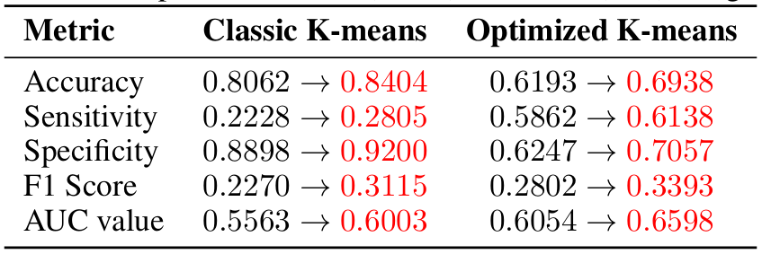
Comparison

Slide 16
Naives bayes

Slide 17
Naives bayes
Preprocessing:
CLAHE (Contrast Limited Adaptive Histogram Equalization) for local contrast enhancement (LAB color space)
Extracted RGB pixel features within the Field of View (FOV)
Vessel pixels labeled from manual annotations
Class Imbalance Handling:
All vessel pixels retained
Equal number of background pixels sampled
Resulted in a balanced dataset for fair training
Model: Gaussian Naive Bayes (GNB)
Assumes pixel intensities follow a Gaussian distribution per class
Features: RGB values of individual pixels
Posterior probabilities computed to assign class labels (vessel or background)
Notes:
the raw images often have low contrast, making vessel detection difficult. To improve visibility, we applied CLAHE—Contrast Limited Adaptive Histogram Equalization—on the L channel of the LAB color space. This enhanced the local contrast while preserving overall image quality.
From each image, we extracted RGB pixel values only from regions within the Field of view, filtering out background areas. Each pixel served as a sample, and its label—vessel or background—was assigned based on the annotation.
One major challenge was class imbalance. Vessel pixels are far fewer than background pixels. To address this, we retained all vessel pixels and randomly sampled an equal number of background pixels. This helped the model learn balanced decision boundaries.
For the classification model, we implemented a Gaussian Naive Bayes classifier from scratch. It assumes that the features—pixel intensities—are normally distributed and independent across channels. During training, it learns the mean and variance of each class, and during prediction, it computes the posterior probability for each pixel belonging to each class and assigns the label with the highest probability."

Slide 18
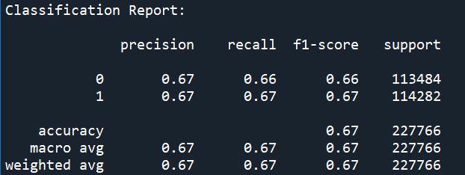
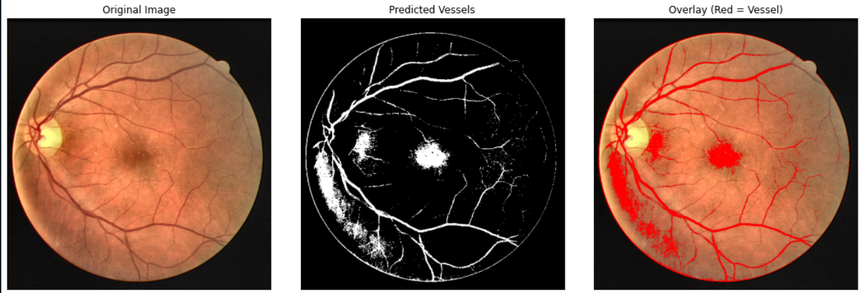
Results
Notes:
Now let’s talk about the results of the segmentation model.
On the test set, the model achieved an overall accuracy of 67% and a ROC AUC score of 0.666. While this might not seem very high compared to modern deep learning models, it is actually quite reasonable for a pixel-wise classifier that relies purely on color information and doesn’t consider spatial relationships.
If we break this down further, we can see from the confusion matrix that the model has relatively balanced performance across both classes. It correctly predicted about 76,872 vessel pixels and 74,767 background pixels.
The precision and recall for both classes are also around 67%, indicating a consistent but moderate level of sensitivity and specificity.
Visually, the model performs quite well in identifying major blood vessels, but it tends to miss very fine capillaries, which is expected due to the limitations of the Naive Bayes approach and the limited input features.
One key takeaway is that, although this method is simple, it establishes a solid baseline and allows for easy interpretability. It also serves as a useful reference point for comparing more complex models.
For future work, we suggest exploring deep learning approaches like CNNs or U-Net, which can take into account both color and spatial context, and are well-suited for capturing the intricate patterns of retinal vasculature."

Slide 19
SVM

Slide 20
SVM
Implemented soft-margin SVM using RBF kernel for non-linear classification
Solved the dual optimization problem using cvxopt quadratic programming
Handled class imbalance by adjusting sample weights manually
Identified support vectors from non-zero Lagrange multipliers (α > 1e-5)
Applied Platt scaling (logistic regression) to convert decision scores into probabilities
Achieved end-to-end training, prediction, and probability output

Slide 21
Results of SVM of two versions
Result of Custom SVM (build from scratch)
Result of SVC from Scikit-learn
Precision | 0.22
Recall | 0.11
F1 Score | 0.14
Accuracy | 0.84
AUC | 0.60
Precision | 0.21
Recall | 0.62
F1 Score | 0.31
Accuracy | 0.65
AUC | 0.69

Slide 22
Why did the Custom SVM underperform the Scikit-learn?
Subsampled data (15%) limits model’s ability to generalize, especially on minority class.
No solver optimizations like SMO, kernel caching, or shrinking heuristics used in sklearn.
Fixed hyperparameters without tuning (C, γ) reduce classification performance.

Slide 23
Random Forest

Slide 24
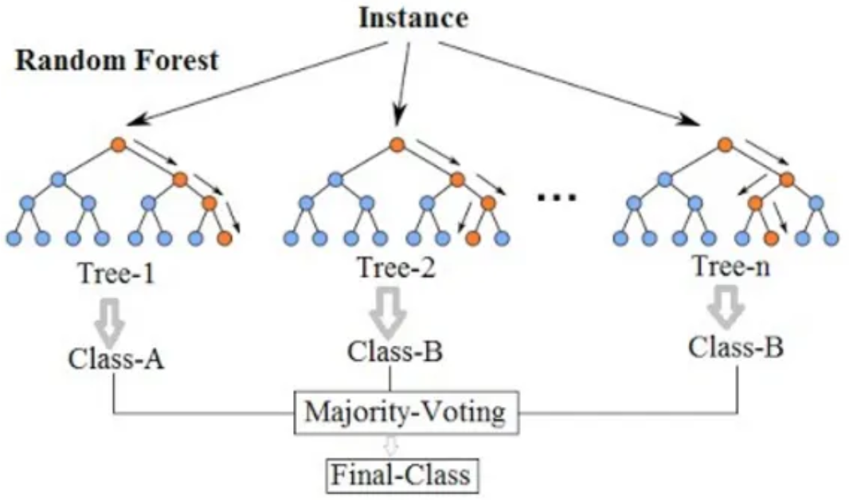
Random Forest for Image Segmentation:
Image Segmentation can be regarded as a Classification Problem with RGB value as its feature.
Pro: Suitable for small data set. Resist Overfitting. Con: Spatial continuity information is lost during training.

Slide 25
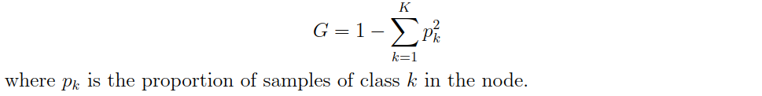

Node-Splitting Score
Gini Impurity
Information Gain

Slide 26
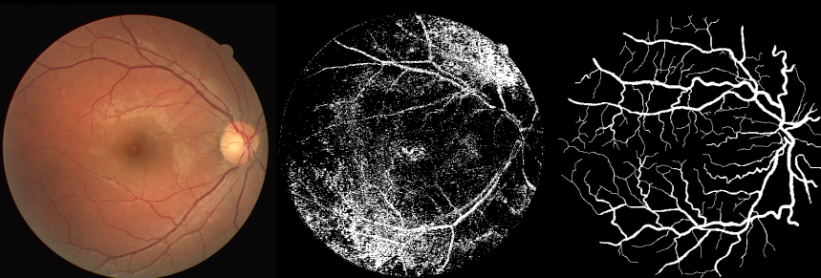
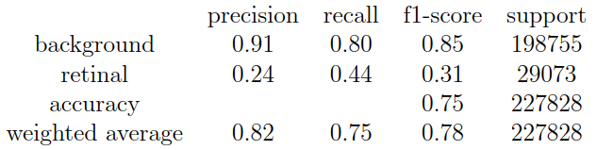
Result

Slide 27
Conclusions

Slide 28
Conclusions
 | K-means | RF | SVM | Naive Bayes
AUC | 0.66 | 0.62 | 0.60 | 0.72
The optimized K-means clustering approach yielded notable improvements in sensitivity and AUC compared to the classic K-means variant, even reaching the level of supervised learning methods.
This shows that designing the models towards the data has a chance to make the performance of the unsupervised learning model better than that of the supervised learning model.

Slide 29

Thanks!

